Slide 1
FinCEN’s Residential Real Estate Rule & REALTORs
It’s time to discuss federal requirements that will affect closings beginning December 1, 2025

Slide 2
Agenda
Who is FinCEN?
What is the Residential Real Estate Rule?
What Will Be Required?
How Will This Affect Closing?

Slide 3
FinCEN – Financial Crimes Enforcement Network
Created by Congress
Part of the Treasury Department
Mission: “…to safeguard the system from illicit use, combat money laundering and its related crimes including terrorism, and promote national security through the strategic use of financial authorities and the collection, analysis, and dissemination of financial intelligence.”
Creates Rules Like Residential Real Estate Rule to Fulfill Mission

Slide 4
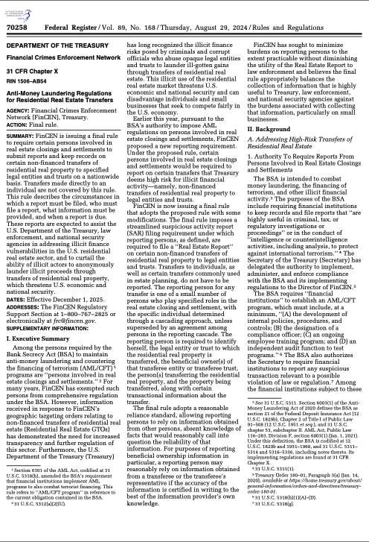
What is a RRER?
Report of details of residential cash transactions to entities or trusts to FinCEN
Also includes transactions involving hard money/private lenders

Slide 5
What is the Purpose?
Money-laundering occurs in residential transactions that helps:
  Terrorists
  Drug Lords
Entities and Trusts identification in land records do not disclose who is the Beneficial Owner (the person who controls the money) unless a separate report is made
FinCEN wants to know the individual’s name because then
  They can correlate to other data to stop money-laundering
  Hopefully, money-launderers quit using the residential real estate market

Slide 6
What Information is Required?
Buyer – Entity/Trust Details and Identification of the Beneficial Owner including address, SSN, and/or Passport Number
Seller – Individual’s Information or if an entity or trust, information about the entity or trust and Beneficial Owner Information
Property Details
Banking Information for Buyers including Source of Funds
REQUIRED: Buyer and Seller Collection of Information Forms.

Slide 7
How Will This Affect Closing?
Buyers and Sellers will have to submit information to our agency (before closing, at closing, before closing will be scheduled) using (insert how you will obtain information - portal, fillable form, encrypted email, etc.)
This process will require Buyers and Sellers (or acceptable representatives to your agency) to certify the accuracy of the information in writing to (closer, FinCEN team lead, whomever)
After closing, our office will handle the filing with FinCEN

Slide 8
Form Changes?
Title Commitment - Schedule B(i) will have a requirement to provide this information prior to or at closing.
What about your forms? Consider changing standard Purchase Agreement Language to account for these changes so all REALTORs know the transaction could or will require FinCEN reporting.

Slide 9
Will there be charges?
For complying with FinCEN, the following charges will apply:
  (Insert charges agency will assess to buyer)
  (Rush charges?)
  (Where will it appear on Settlement Statement)

Slide 10
This is Required. No One Wants to Go to Jail.
Mens Rea | Fine or Penalty? | Criminal?
Negligent? | Not more than $1,394 per violation; up to $108,489 for a pattern | No
Willful? | Criminal – up to $250,000 Civil – Not more than the greater amount involved in the transaction (not to exceed $278,937) or $69,733 | Yes, up to five years in prison

Slide 11
How Can We Work Together to Make this SMOOTHER?
Ask Your Buyers At Contracting Whether an Entity or Trust Will Be Used
Tell Us at Order Entry
If a Buyer Changes Their Mind, Tell Us ASAP so Closing is NOT Delayed
If Your Buyer is Hesitant
  Stopping Money-Laundering
  Required by Federal Government
  Information Obtained & Stored Securely
  Have Them Speak to Us About Processes

Slide 12
THANK YOU.
Questions?

